Slide 1
Theory Of Automata
LECTURE 32 & 33
SIMPLIFICATION of CFG,
NORMAL FORMS of CFG
Instructor: Sulaman Ahmad Naz

Slide 2
Introduction
Usually CFG productions may be of any format.
There may be many useless symbols in the language.
Some of these symbols may not generate any terminal string.
Some may be non-reachable.

Slide 3
Introduction
Sometimes, there may be unit productions in our CFG.
Similarly, there is no need to have any NULL production in the CFG if the language does not contain the NULL STRING.
All of these issues may result in increasing the number of derivation steps for a language. So, definitely we need to simplify the CFG.

Slide 4
Introduction
Sometimes, we need the RHS of all productions to be in some specific format.
These specific formats are called the Normal Forms of a CFG.
There are two widely used Normal forms:
Chomsky Normal Form (CNF)
Greibach Normal Form (GNF)

Slide 5
Applications of CNF
If a CFG is in CNF, it can be used by CYK (a polynomial time bottom-up parsing algorithm) to check whether a particular string is generated by the language or not.
It is also used to prove the pumping lemma for CFLs.

Slide 6
Applications of GNF
GNF can be used to easily design a PDA accepting the CFL.
In a GNF grammar, any derivable string of length n can be produced with exactly n production steps.
Another important application of Greibach Normal Form is in the proof of theorems like Shamir’s theorem.

Slide 7
Conversion Flowchart
Simplification of CFG
Removal of all null-productions
Conversion to CNF
Removal of all unit-productions
CFG →
CNF
↓
GNF
Removal of non-generating symbols
Conversion to GNF
Removal of non-reachable symbols

Slide 8
Removal of Useless Symbols
Useless symbols are of two types:
Non-generating symbols are those symbols which do not produce any terminal string.
Non-reachable symbols are those symbols which cannot be reached at any time starting from the start symbol.
If any symbol is found guilty, remove all the productions that contain that symbol on either side of →.
Remember that if the start symbol is found non-generating, we will not remove it.

Slide 9
Example
Remove the useless symbols from the given CFG:
S → AC
S → BA
C → CB
C → AC
A → a
B → aC
B → b
A generates a.
B generates b.
C always calls itself.

Slide 10
Example
Remove the useless symbols from the given CFG:
S → AC
S → BA
C → CB
C → AC
A → a
B → aC
B → b
C is found guilty.

Slide 11
Example
Remove the useless symbols from the given CFG:
S → BA
A → a
B → b
No symbol is non-reachable
This is the required minimized CFG.

Slide 12
Task 1
Remove the useless symbols from the given CFG:
S → aAa
A → bBB
B → ab
C → aB
A generates babab.
B generates ab.
C generates aab.

Slide 13
Task 1
Remove the useless symbols from the given CFG:
S → aAa
A → bBB
B → ab
C → aB
None is found guilty.

Slide 14
Task 1
Remove the useless symbols from the given CFG:
S → aAa
A → bBB
B → ab
C → aB
A is reachable.
B is reachable.
C is not reachable.

Slide 15
Task 1
Remove the useless symbols from the given CFG:
S → aAa
A → bBB
B → ab
C → aB
C is found guilty.

Slide 16
Task 1
Remove the useless symbols from the given CFG:
S → aAa
A → bBB
B → ab
This is the required minimized CFG.

Slide 17
Task 2
Remove the useless symbols from the given CFG:
S → aC
S → SB
A → bSCa
A → ad
B → aSB
B → bBC
C → aBC
C → ad
A generates ad.
B always calls B.
C generates ad.

Slide 18
Task 2
Remove the useless symbols from the given CFG:
S → aC
S → SB
A → bSCa
A → ad
B → aSB
B → bBC
C → aBC
C → ad
B is found guilty.

Slide 19
Task 2
Remove the useless symbols from the given CFG:
S → aC
A → bSCa
A → ad
C → ad
A is not reachable.
C is reachable.

Slide 20
Task 2
Remove the useless symbols from the given CFG:
S → aC
A → bSCa
A → ad
C → ad
A is found guilty.

Slide 21
Task 2
Remove the useless symbols from the given CFG:
S → aC
C → ad
This is the required minimized CFG.

Slide 22
Removal of Unit Productions
A production is called a unit-production if it is in the following format:
Non-terminal → single non-terminal
Unit productions increase the number of steps as well as the time complexity at the time of generating language.

Slide 23
Removal of Unit Productions
Let the CFG be:
S → AB
A → E
B → C
C → D
D → b
E → a
S ⇒ AB
⇒ EB
⇒ aB
⇒ aC
⇒ aD
⇒ ab
6 steps

Slide 24
Removal of Unit Productions
Let the CFG be:
S → AB
A → E
B → C
C → D
D → b
E → a
S ⇒ AB
⇒ EB
⇒ aB
⇒ aC
⇒ aD
⇒ ab
6 steps
Unit
productions

Slide 25
Removal of Unit Productions
After removing the unit-productions, CFG is:
S → AB
A → a
B → b
S ⇒ AB
⇒ aB
⇒ ab
3 steps

Slide 26
Removal of Unit Productions
While (unit-production exists)
do
{
select a unit production, say A→B
for(every non-unit production B→x_{i})
{
add production A→x_{i} to CFG
}
remove A→B from CFG
}

Slide 27
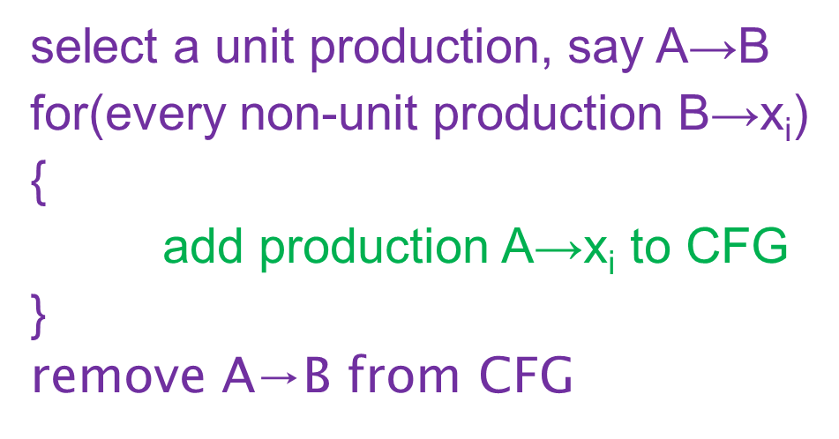
Example
Let the CFG:
S → AB
A → E
B → C
C → D
D → b
E → a
A → E E → a
A → a

Slide 28
Example
CFG:
S → AB
B → C
C → D
D → b
E → a
A → a
C → D D → b
C → b

Slide 29
Example
CFG:
S → AB
B → C
D → b
E → a
A → a
C → b
B → C C → b
B → b

Slide 30
Example
CFG:
S → AB
D → b
E → a
A → a
C → b
B → b
Every Symbol is generating.
D, E & C are non-reachable.

Slide 31
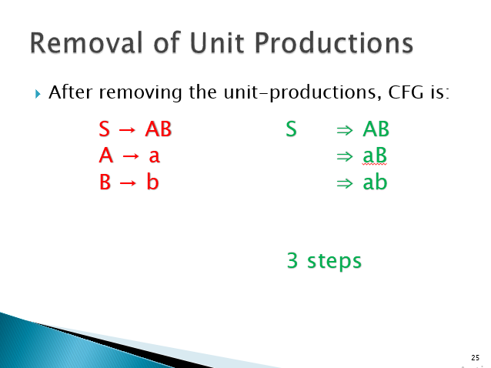
Example
CFG:
S → AB
A → a
B → b
This is the required minimized CFG.

Slide 32
Task 3
Let the CFG:
S → AB
A → a
B → C
C → D
D → b
C → D D → b
C → b

Slide 33
Task 3
CFG:
S → AB
A → a
B → C
D → b
C → b
B → C C → b
B → b

Slide 34
Task 3
CFG:
S → AB
A → a
D → b
C → b
B → b
Every Symbol is generating.
D & C are non-reachable.

Slide 35
Task 3
CFG:
S → AB
A → a
B → b
This is the required minimized CFG.

Slide 36
Task 4
Let the CFG:
S → aX
S → Yb
S → Y
X → S
Y → Yb
Y → b
S → Y Y → Yb
Y → b
S → Yb
S → b

Slide 37
Task 4
CFG:
S → aX
S → Yb
X → S
Y → Yb
Y → b
S → b
X → S S → aX
S → Yb
S → b
X → aX
X → Yb
X → b

Slide 38
Task 4
CFG:
S → aX
S → Yb
Y → Yb
Y → b
S → b
X → aX
X → Yb
X → b
Every Symbol is generating.
Every symbol is reachable.

Slide 39
Task 4
CFG:
S → aX
S → Yb
Y → Yb
Y → b
S → b
X → aX
X → Yb
X → b
This is the required minimized CFG.

Slide 40
Task 5
Let the CFG:
S → AA
A → B
A → BB
B → abB
B → b
B → bb
A → B B → abB
B → b
B → bb
A → abB
A → b
A → bb

Slide 41
Task 5
CFG:
S → AA
A → BB
B → abB
B → b
B → bb
A → abB
A → b
A → bb
Every Symbol is generating.
Every symbol is reachable.

Slide 42
Task 5
CFG:
S → AA
A → BB
B → abB
B → b
B → bb
A → abB
A → b
A → bb
This is the required minimized CFG.

Slide 43
Removal of Null Productions
A production is called a null-production if it is in the following format:
Non-terminal → Λ
If Λ is in the language set of CFG, then it cannot be eliminated.

Slide 44
Removal of Null Productions
If A→Λ is a null production, then select all production rules where RHS contains A.
For all these selected production rules, remove A one by one to add new rules in CFG.
Remove A→Λ from CFG.
Repeat the above steps for all null-productions.

Slide 45
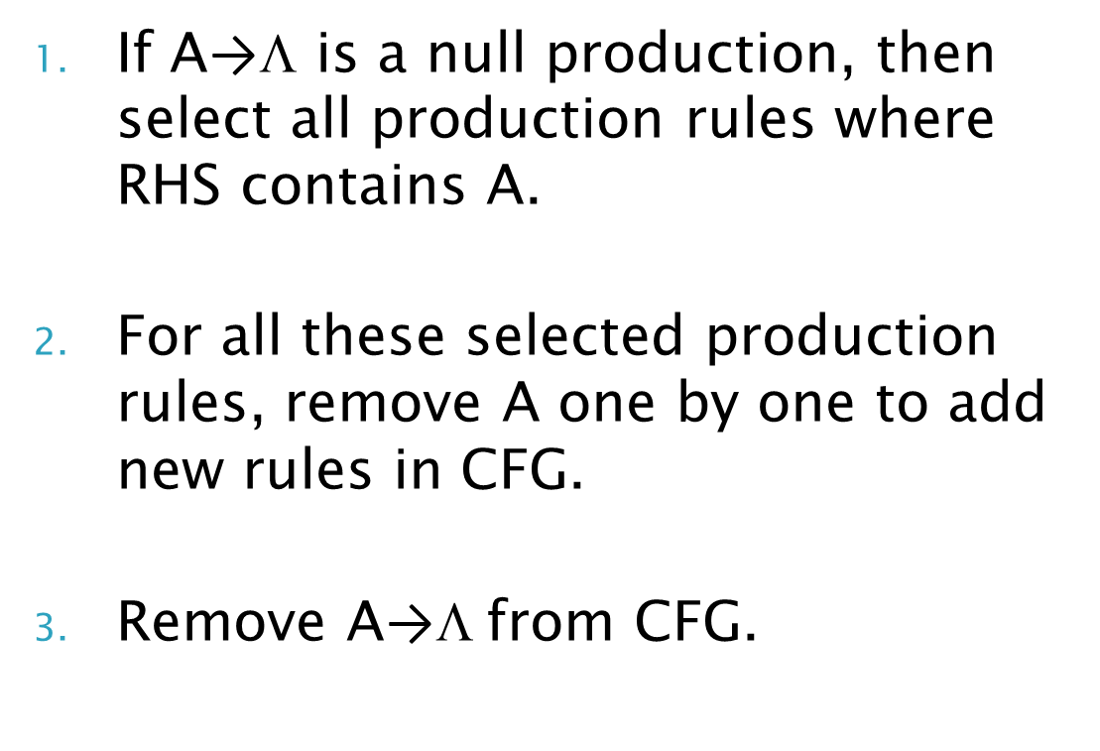
Example
Let the CFG:
S → aA
A → Λ
A → b
S → aA
S → a

Slide 46
Example
CFG:
S → aA
A → b
S → a
There is no unit-production.
Every Symbol is generating.
Every symbol is reachable.

Slide 47
Example
CFG:
S → aA
A → b
S → a
This is the required minimized CFG.

Slide 48
Task 6
Let the CFG:
S → aX
S → bX
X → Λ
X → a
X → b
S → aX S → bX
S → a S → b

Slide 49
Task 6
CFG:
S → aX
S → bX
X → a
X → b
S → a
S → b
There is no unit-production.
Every Symbol is generating.
Every symbol is reachable.

Slide 50
Task 6
CFG:
S → aX
S → bX
X → a
X → b
S → a
S → b
This is the required minimized CFG.

Slide 51
Task 7
Let the CFG:
S → ABaC
A → BC
B → Λ
B → b
C → Λ
C → D
D → d
S → ABaC A → BC
S → AaC A → C

Slide 52
Task 7
CFG:
S → ABaC
A → BC
B → b
C → Λ
C → D
D → d
S → AaC
A → C
S → ABaC A → BC
S → ABa A → B
S → AaC A → C
S → Aa A → Λ

Slide 53
Task 7
CFG:
S → ABaC|ABa
A → BC
A → B
B → b
C → D
D → d
S → AaC|Aa
A → C
A → Λ
S → ABaC|ABa
S → BaC|Ba
S → AaC|Aa
S → aC|a

Slide 54
Task 7
CFG:
S → ABaC|ABa
S → BaC|Ba
A → BC
A → B
B → b
C → D
D → d
S → AaC|Aa|aC|a
A → C
There are 3 unit-productions.

Slide 55
Task 7
CFG:
S → ABaC|ABa
S → BaC|Ba
A → BC
A → B
B → b
C → D
D → d
S → AaC|Aa|aC|a
A → C
A → B B → b
A → b

Slide 56
Task 7
CFG:
S → ABaC|ABa
S → BaC|Ba
A → BC
A → b
B → b
C → D
D → d
S → AaC|Aa|aC|a
A → C
C → D D → d
C → d

Slide 57
Task 7
CFG:
S → ABaC|ABa
S → BaC|Ba
A → BC
A → b
B → b
C → d
D → d
S → AaC|Aa|aC|a
A → C
A → C C → d
A → d

Slide 58
Task 7
CFG:
S → ABaC|ABa
S → BaC|Ba
A → BC
A → b
B → b
C → d
D → d
S → AaC|Aa|aC|a
A → d
Every Symbol is generating.
D is not reachable.

Slide 59
Task 7
CFG:
S → ABaC|ABa
S → BaC|Ba
A → BC
A → b
B → b
C → d
S → AaC|Aa|aC|a
A → d
This is the required minimized CFG.

Slide 60
Task 7
CFG:
S → ABaC|ABa|AaC|BaC|Ba|Aa|aC|a
A → BC|b|d
B → b
C → d
This is the required minimized CFG.

Slide 61
Task 8
Let the CFG:
S → ABAC
A → aA
A → Λ
B → bB
B → Λ
C → c
S → ABAC A → aA
S → BAC A → a
S → ABC
S → BC

Slide 62
Task 8
CFG:
S → ABAC
A → aA
B → bB
B → Λ
C → c
S → BAC
S → ABC
S → BC
A → a
S → ABAC|BAC|ABC|BC
S → AAC|AC|C
B → bB
B → b

Slide 63
Task 8
CFG:
S → ABAC
A → aA
B → bB|b
C → c
S → BAC|ABC|BC
A → a
S → AAC|AC
S → C

Slide 64
Task 8
CFG:
S → ABAC
A → aA
B → bB|b
C → c
S → BAC|ABC|BC
A → a
S → AAC|AC
S → C
There is one unit-production

Slide 65
Task 8
CFG:
S → ABAC
A → aA
B → bB|b
C → c
S → BAC|ABC|BC
A → a
S → AAC|AC
S → C
S → C C → c
S → c

Slide 66
Task 8
CFG:
S → ABAC
A → aA
B → bB|b
C → c
S → BAC|ABC|BC
A → a
S → AAC|AC
S → c
Every Symbol is generating.
Every symbol is reachable.

Slide 67
Task 8
CFG:
S → ABAC
A → aA
B → bB|b
C → c
S → BAC|ABC|BC
A → a
S → AAC|AC
S → c
This is the required minimized CFG.

Slide 68
Task 8
CFG:
S → ABAC|BAC|ABC|BC|AAC|AC|c
A → aA|a
B → bB|b
C → c
This is the required minimized CFG.

Slide 69
Task 9
Let the CFG:
S → aS
S → A
A → Λ
A → aA
Here, as ‘S’ is NULLABLE,
so, Λ is the part of the language generated by CFG.
Hence, we will not remove this NULL production now.

Slide 70
Task 9
CFG:
S → aS
S → A
A → Λ
A → aA
However, unit-production will be removed.

Slide 71
Task 9
CFG:
S → aS
S → A
A → Λ
A → aA
S → A A → Λ | aA
S → Λ | aA

Slide 72
Task 9
CFG:
S → aS
A → Λ
A → aA
S → Λ | aA
S → aA A → aA
S → a A → a

Slide 73
Task 9
CFG:
S → aS
A → aA
S → Λ | aA
S → a
A → a
Every Symbol is generating.
Every Symbol is reachable.

Slide 74
Task 9
CFG:
S → aS
A → aA
S → Λ | aA
S → a
A → a
This is the required minimized CFG.

Slide 75
Chomsky Normal Form (CNF)
A CFG is said to be in CNF if all the productions of the grammar are in the following format:
Non-terminal → two non-terminals
Non-terminal → single terminal

Slide 76
Chomsky Normal Form (CNF)
STEP I: Simplification of CFG
Eliminate Λ-Productions.
Eliminate Unit-Productions.
Eliminate Useless Productions.
STEP II: Substitution on RHS
Substitute the terminals on the RHS of length two or more and add new rules.
STEP III: Restriction of RHS
Restrict the number of variables on the RHS to two.

Slide 77
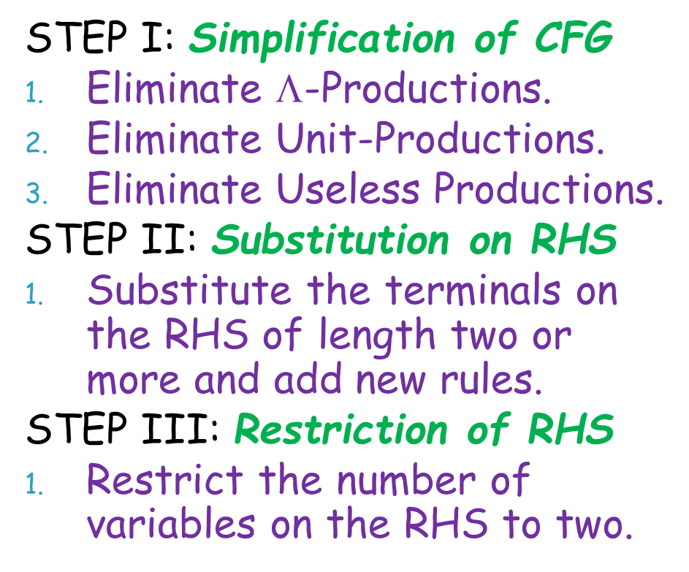
Example
Let the CFG:
S → bA
S → aB
A → bAA
A → aS
A → a
B → aBB
B → bS
B → a
There are no Null productions
There are no Unit productions
Every symbol is generating
Every symbol is reachable

Slide 78
Example
CFG:
S → bA
S → aB
A → bAA
A → aS
A → a
B → aBB
B → bS
B → a
C → b
D → a

Slide 79
Example
CFG:
S → bA
S → aB
A → bAA
A → aS
A → a
B → aBB
B → bS
B → a
C → b
D → a

Slide 80
Example
CFG:
S → CA
S → DB
A → CAA
A → DS
A → a
B → DBB
B → CS
B → a
C → b
D → a

Slide 81
Example
CFG:
S → CA
S → DB
A → CAA
A → DS
A → a
B → DBB
B → CS
B → a
C → b
D → a

Slide 82
Example
CFG:
S → CA
S → DB
A → CAA
A → DS
A → a
B → DBB
B → CS
B → a
C → b
D → a
E → AA
F → BB

Slide 83
Example
CFG:
S → CA
S → DB
A → CAA
A → DS
A → a
B → DBB
B → CS
B → a
C → b
D → a
E → AA
F → BB

Slide 84
Example
CFG:
S → CA
S → DB
A → CE
A → DS
A → a
B → DF
B → CS
B → a
C → b
D → a
E → AA
F → BB
This is the required CNF

Slide 85
Example
CFG:
S → CA|DB
A → CE|DS
A → a
B → DF|CS
B → a
C → b
D → a
E → AA
F → BB
This is the required CNF

Slide 86
Task 10
Let the CFG:
S → ABa
A → aab
B → Ac
There are no Null productions
There are no Unit productions
Every symbol is generating
Every symbol is reachable

Slide 87
Task 10
CFG:
S → ABa
A → aab
B → Ac
C → a
D → b
E → c

Slide 88
Task 10
CFG:
S → ABa
A → aab
B → Ac
C → a
D → b
E → c

Slide 89
Task 10
CFG:
S → ABC
A → CCD
B → AE
C → a
D → b
E → c

Slide 90
Task 10
CFG:
S → ABC
A → CCD
B → AE
C → a
D → b
E → c

Slide 91
Task 10
CFG:
S → ABC
A → CCD
B → AE
C → a
D → b
E → c
F → BC
G → CC

Slide 92
Task 10
CFG:
S → ABC
A → CCD
B → AE
C → a
D → b
E → c
F → BC
G → CC

Slide 93
Task 10
CFG:
S → AF
A → GD
B → AE
C → a
D → b
E → c
F → BC
G → CC
This is the required CNF

Slide 94
Task 10
CFG:
S → AF
A → GD
B → AE
C → a
D → b
E → c
F → BC
G → CC
This is the required CNF

Slide 95
Task 11
Let the CFG:
E → E + E
E → E * E
E → id
There are no Null productions
There are no Unit productions
Every symbol is generating
Every symbol is reachable

Slide 96
Task 11
CFG:
E → E + E
E → E * E
E → id
P → +
M → *

Slide 97
Task 11
CFG:
E → E + E
E → E * E
E → id
P → +
M → *

Slide 98
Task 11
CFG:
E → EPE
E → EME
E → id
P → +
M → *

Slide 99
Task 11
CFG:
E → EPE
E → EME
E → id
P → +
M → *

Slide 100
Task 11
CFG:
E → EPE
E → EME
E → id
P → +
M → *
C₁ → EP
C₂ → EM

Slide 101
Task 11
CFG:
E → EPE
E → EME
E → id
P → +
M → *
C₁ → EP
C₂ → EM

Slide 102
Task 11
CFG:
E → C₁E
E → C₂E
E → id
P → +
M → *
C₁ → EP
C₂ → EM
This is the required CNF

Slide 103
Task 11
CFG:
E → C₁E
E → C₂E
E → id
P → +
M → *
C₁ → EP
C₂ → EM
This is the required CNF

Slide 104
Practice Question
Convert the following CFG into CNF.
S → abAB
A → bAB|Λ
B → BAa|Λ

Slide 105
Greibach Normal Form (GNF)
A CFG is said to be in GNF if all the productions of the grammar are in the following format:
Non-terminal → <single terminal> <some variables>
Non-terminal → single terminal

Slide 106
Greibach Normal Form (GNF)
STEP I: Prerequisite Conversion
Convert CFG to CNF.
STEP II: Greibach Conversion
Rename all the Variables in ascending order as A_{i}.
Make sure that LHS variable subscript is always less than the leftmost variable subscript on RHS.
If needed, make proper substitutions.
Remove Left Recursion, if any.
Make proper substitutions until we get GNF.

Slide 107
Removing Left Recursion
Let we have a CFL with Left Recursion Problem:
To remove left recursion, follow the following steps:
Eliminate the symbol S where it causes left recursion.
Make new production for new symbol B, producing the leftover with and without right recursion.
Remove the problematic production.
Add the new symbol B on the extreme right of all other productions of S to form new productions.
S → SaA | aa
A → b
S → aaB | aa
B → aAB | aA
A → b

Slide 108
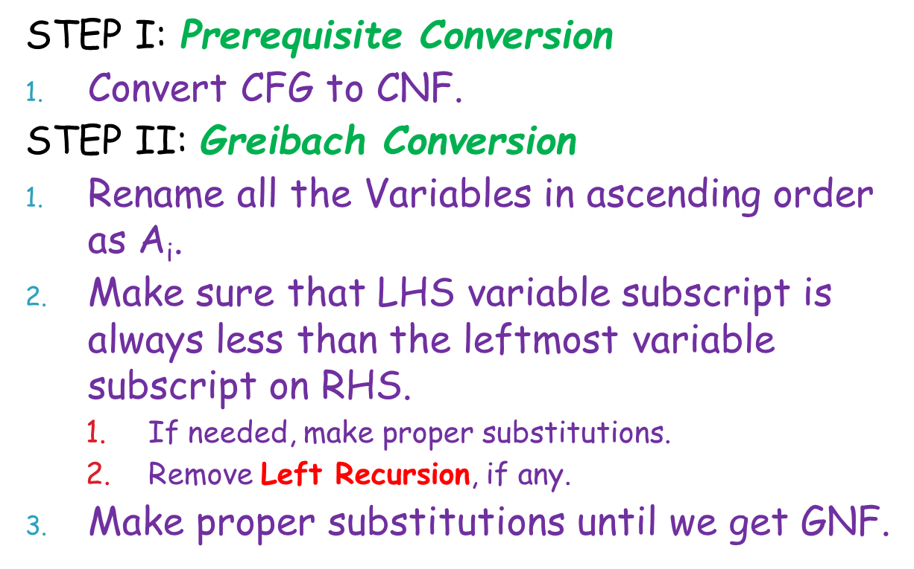
Example
Let the CFG:
S → AA | a
A → SS | b
The CFG is already in CNF,
so we can proceed to next step.

Slide 109
Example
CFG:
S → AA | a
A → SS | b
After renaming the variables:
A₁ → A₂A₂ | a
A₂ → A₁A₁ | b

Slide 110
Example
CFG:
A₁ → A₂A₂ | a
A₂ → A₁A₁ | b
Second production violates the criteria,
So we substitute the value of A₁.
A₁ → A₂A₂ | a
A₂ → A₂A₂A₁ | aA₁ | b

Slide 111
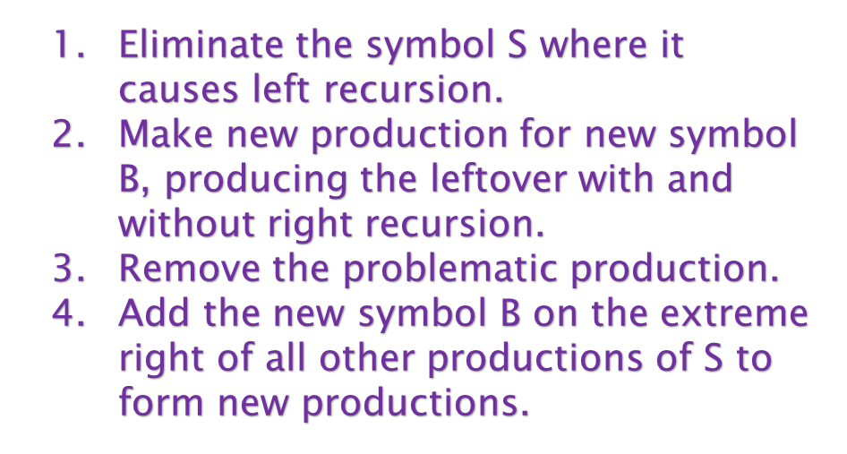
Example
CFG:
A₁ → A₂A₂ | a
A₂ → A₂A₂A₁ | aA₁ | b
Now we will remove Left Recursion.
A₁ → A₂A₂ | a
A₂ → aA₁ | b
B → A₂A₁ | A₂A₁B
A₂ → aA₁B | bB

Slide 112
Example
CFG:
A₁ → A₂A₂ | a
A₂ → aA₁ | b | aA₁B | bB
B → A₂A₁ | A₂A₁B
Substituting the value of A₂.
A₁ → aA₁A₂ | bA₂ | aA₁BA₂ | bBA₂ | a
A₂ → aA₁ | b | aA₁B | bB
B → A₂A₁ | A₂A₁B

Slide 113
Example
CFG:
B → A₂A₁ | A₂A₁B
A₁ → aA₁A₂ | bA₂ | aA₁BA₂ | bBA₂ | a
A₂ → aA₁ | b | aA₁B | bB
Substituting the value of A₂.
A₁ → aA₁A₂ | bA₂ | aA₁BA₂ | bBA₂ | a
A₂ → aA₁ | b | aA₁B | bB
B → aA₁A₁ | bA₁ | aA₁BA₁ | bBA₁
B → aA₁A₁B | bA₁B | aA₁BA₁B | bBA₁B

Slide 114
Example
CFG:
A₁ → aA₁A₂ | bA₂ | aA₁BA₂ | bBA₂ | a
A₂ → aA₁ | b | aA₁B | bB
B → aA₁A₁ | bA₁ | aA₁BA₁ | bBA₁
B → aA₁A₁B | bA₁B | aA₁BA₁B | bBA₁B
Here is the required GNF.

Slide 115
Task 12
Let the CFG:
S → CA | BB
B → b | SB
C → b
A → a
The CFG is already in CNF,
so we can proceed to next step.

Slide 116
Task 12
CFG:
S → CA | BB
B → b | SB
C → b
A → a
After renaming the variables:
A₁ → A₂A₃ | A₄ A₄
A₄ → b | A₁A₄
A₂ → b
A₃ → a

Slide 117
Task 12
CFG:
A₁ → A₂A₃ | A₄ A₄
A₄ → b | A₁A₄
A₂ → b
A₃ → a
Second production violates the criteria,
So we substitute the value of A₁.
A₁ → A₂A₃ | A₄ A₄
A₄ → b | A₂A₃A₄ | A₄A₄A₄
A₂ → b
A₃ → a

Slide 118
Task 12
CFG:
A₁ → A₂A₃ | A₄ A₄
A₄ → b | A₂A₃A₄ | A₄A₄A₄
A₂ → b
A₃ → a
Again, second production violates the criteria,
So we substitute the value of A₂.
A₁ → A₂A₃ | A₄ A₄
A₄ → b | bA₃A₄ | A₄A₄A₄
A₂ → b
A₃ → a

Slide 119
Task 12
CFG:
A₁ → A₂A₃ | A₄ A₄
A₄ → b | bA₃A₄ | A₄A₄A₄
A₂ → b
A₃ → a
Now we will remove Left Recursion.
A₁ → A₂A₃ | A₄ A₄
A₄ → b | bA₃A₄
A₂ → b
A₃ → a
Z → A₄A₄ | A₄A₄Z
A₄ → bZ | bA₃A₄Z

Slide 120
Task 12
CFG:
A₁ → A₂A₃ | A₄ A₄
A₂ → b
A₃ → a
Z → A₄A₄ | A₄A₄Z
A₄ → b | bA₃A₄ | bZ | bA₃A₄Z
Substituting the value of A₂.
A₁ → bA₃ | A₄ A₄
A₂ → b
A₃ → a
Z → A₄A₄ | A₄A₄Z
A₄ → b | bA₃A₄ | bZ | bA₃A₄Z

Slide 121
Task 12
CFG:
A₁ → bA₃ | A₄ A₄
A₂ → b
A₃ → a
Z → A₄A₄ | A₄A₄Z
A₄ → b | bA₃A₄ | bZ | bA₃A₄Z
Substituting the value of A₄.
A₁ → bA₃ | bA₄ | bA₃A₄A₄ | bZA₄ | bA₃A₄ZA₄
A₂ → b
A₃ → a
Z → bA₄ | bA₃A₄A₄ | bZA₄ | bA₃A₄ZA₄
Z → A₄A₄Z
A₄ → b | bA₃A₄ | bZ | bA₃A₄Z

Slide 122
Task 12
CFG:
A₂ → b
A₃ → a
Z → A₄A₄Z
Z → bA₄ | bA₃A₄A₄ | bZA₄ | bA₃A₄ZA₄
A₁ → bA₃ | bA₄ | bA₃A₄A₄ | bZA₄ | bA₃A₄ZA₄
A₄ → b | bA₃A₄ | bZ | bA₃A₄Z
Substituting the value of A₄.
A₂ → b
A₃ → a
Z → bA₄Z | bA₃A₄A₄Z | bZA₄Z | bA₃A₄ZA₄Z
Z → bA₄ | bA₃A₄A₄ | bZA₄ | bA₃A₄ZA₄
A₁ → bA₃ | bA₄ | bA₃A₄A₄ | bZA₄ | bA₃A₄ZA₄
A₄ → b | bA₃A₄ | bZ | bA₃A₄Z

Slide 123
Task 12
CFG:
A₂ → b
A₃ → a
Z → bA₄Z | bA₃A₄A₄Z | bZA₄Z | bA₃A₄ZA₄Z
Z → bA₄ | bA₃A₄A₄ | bZA₄ | bA₃A₄ZA₄
A₁ → bA₃ | bA₄ | bA₃A₄A₄ | bZA₄ | bA₃A₄ZA₄
A₄ → b | bA₃A₄ | bZ | bA₃A₄Z
Here is the required GNF.

Slide 124
Practice Question
Convert the following two CFGs into GNF.
S → XY
X → YS | b
Y → SX | a
S → AB | BC
A → aB | bA | a
B → bB | cC | b
C → c

Slide 125
Reading Assignment
Chapter 16
Page 302 - 330

Slide 126
Practice Questions
Chapter 16
All Related Questions

Slide 127
Thanks
End of Lecture
Q/A

